Slide 1
dbt Introduction
Data Build Tool, commonly known as dbt, has gained recently significant popularity in the realm of data pipelines.
dbt is a data transformation tool. Its purpose is to allow development of data transformation steps that are well documented, reusable, and testable.
dbt (Data Build Tool) is an open-source analytics engineering tool that focuses on the T in the ELT (Extract, Load, Transform) process. It enables data teams to transform raw data into clean, analytics-ready datasets directly within their data warehouse using SQL. Founded in 2016 by Fishtown Analytics (now dbt Labs) as an open-source project. Unlike traditional ETL tools, dbt transforms data directly within the data warehouse using SQL

Slide 2
dbt Advantages
SQL-Based Transformations: Leverages familiar SQL syntax, making it accessible for analysts and engineers.​
Modular and Reusable Code: Encourages breaking down complex transformations into smaller, reusable models, enhancing maintainability. Use control flow statements and loops within your SQL queries for greater flexibility and code reuse
​Version Control Integration: Works seamlessly with Git, enabling collaboration and tracking of changes.​
Automated Testing: Includes built-in testing frameworks to ensure data quality and integrity.​
Documentation Generation: Automatically generates documentation, improving transparency and understanding of data models.​
Data Lineage Visualization: Provides clear visualizations of data flow and dependencies, aiding in debugging and impact analysis.​
Community Support: Backed by a vibrant open-source community, offering a wealth of resources and shared knowledge.
Data Snapshots: Capture historical data at specific points in time to analyze trends and changes effectively
Seed Files: Load static or infrequently changing data from CSV files to enrich your models.
Dependency Management: Define how models are executed, ensuring data transformations happen in the correct sequence

Slide 3
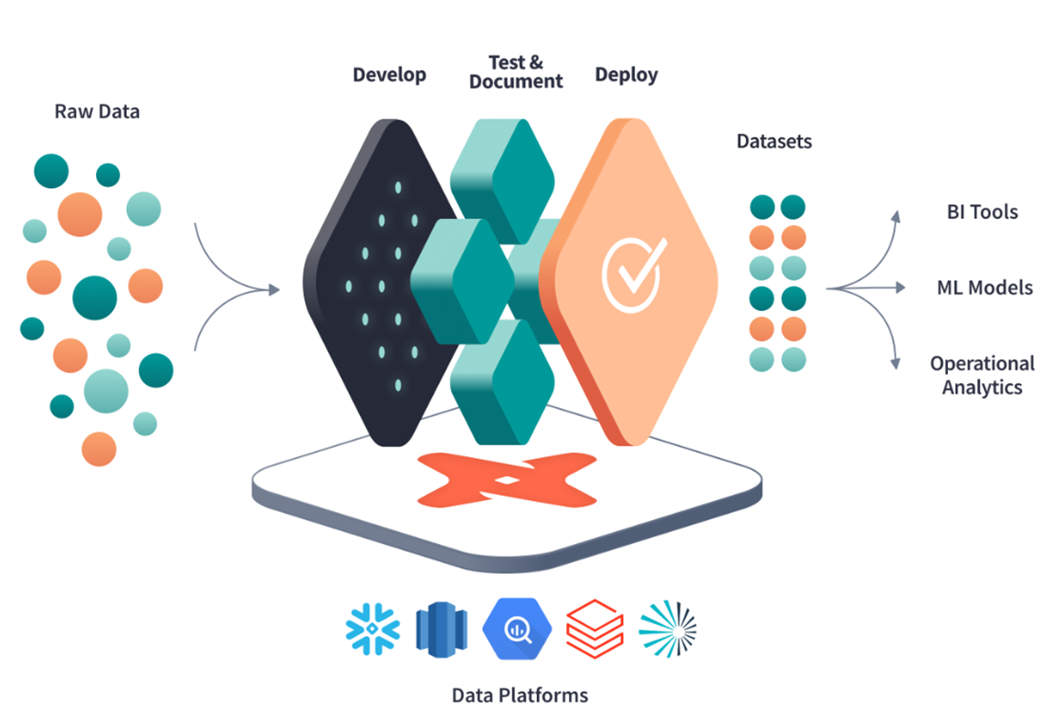
dbt overview

Slide 4
Why dbt?
Transparency: Provides clear, auditable code and documentation.​
Empowers Analysts: Write transformations in pure SQL without deep engineering expertise.
Collaboration-First: Supports version control, shared documentation, and modular development (via ref and macros).
Test-Driven Development: Built-in automated testing ensures data quality and trust in analytics.
Push-Down Processing: Executes transformations directly in the data warehouse (e.g., Snowflake, BigQuery) — no data movement, faster execution, and better security.
No ETL Servers Needed: dbt acts as a lightweight orchestration layer — everything runs inside your warehouse.
Handles Large-Scale Data: Optimized for modern cloud data warehouses with support for massive transformations.

Slide 5
dbt Core vs dbt Cloud
Feature | dbt Core (Open Source) | dbt Cloud (Managed Platform)
Availability | Free & Open Source | Free for individuals, Paid for teams
Execution Interface | Command Line Interface (CLI) | Web-based UI with built-in IDE
Installation | Local machine or custom deployment | No installation needed (SaaS)
Scheduling & Orchestration | Manual or with external schedulers (e.g., Airflow) | Built-in job scheduling and orchestration
Logging & Monitoring | Custom setup required | Centralized logs, alerts, and run history
Authentication | Manual credentials setup | SSO, OAuth, and user management
Documentation Hosting | Local static files | Hosted, searchable, and interactive docs
Collaboration | Git + local dev workflows | Team-based workflows, pull requests, and reviews
Use Case | Developers comfortable with CLI | Teams or individuals wanting ease of use, monitoring, and scalability

Slide 6

dbt core Installation setup
STEP 1 : INSTALL PYTHON
https://www.python.org/downloads/release/python-3127/ Install windows installer 64 bit ( Make sure your python version is 3.12.7 )
STEP 2 : Check version
Open CMD → Check python version if this is successfully installed
Python –version

Slide 7
Step 3 : Create folder in your computer to manage Scripts & Code
Foldername : Anything (dbtlearning)
CMD→ go to that folder path by this command.
STEP 4: Create Virtual Environement (dbtenv something like that)
Run below command :
python -m venv <name> ( you can name anything like dbtenv)

Slide 8
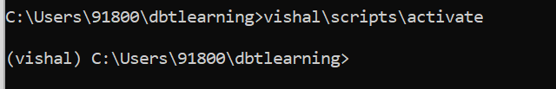
STEP 5 : Activate your virtual environment
Scripts\Activate -- Here Vishal is the name of my virtual environment in below command.
STEP 6 : Once you are in your Virtual environment, run below command to install dbt.
Pip install dbt-snowflake

Slide 9
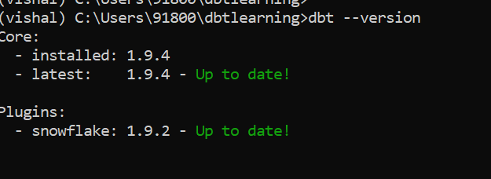
STEP 7 : CHECK dbt core version .
If you are seeing same as Screenshot,
Congratulation , You are all set up ☺

Slide 10
NEXT STEPS
Create your Snowflake Account ready .
Once you are done with Account creation run below commands to create DB and Schema,
CREATE DATABASE DBT_DEV;
CREATE SCHEMA BRONZE_LAYER;
Get ready with your below Snowflake details
Account identifier :
Username:
Password :
Warehouse:

Slide 11
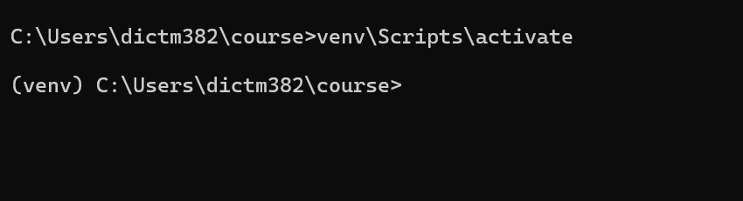
DBT Core Setup Script
Step1: Invoke virtual environment:
Step2: Initialize DBT project with dbt init command:
dbt init
Enter a name for your project (letters, digits, underscore): dbt_training
Setting up your profile.Which database would you like to use?
[1] snowflake
- go to accounts in snowflake and copy the below format and give in below command: account (https://<this_value>.snowflakecomputing.com): Snowflake

Slide 12
Step 3:
role (dev role): SYSADMIN warehouse (warehouse name): COMPUTE_WH
database (default database that dbt will build objects in): DBT_DEMO schema (default schema that dbt will build objects in): PUBLIC
threads (1 or more) [1]: 4

Slide 13
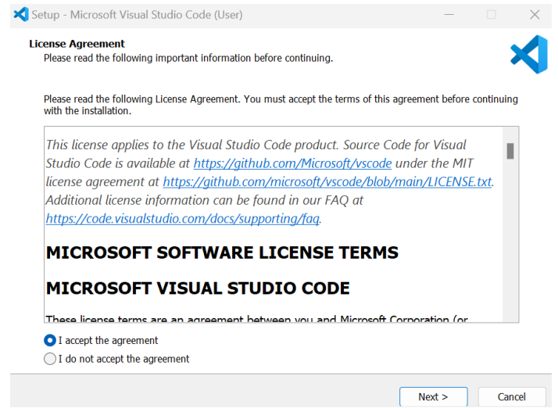
INSTALL VISUAL STUDIO CODE
VS code setup: Download Visual Studio Code - Mac, Linux, Windows for Visual Studio Code
Step1: Open downloaded installer file
Step2: Select I accept the agreement and check Next

Slide 14
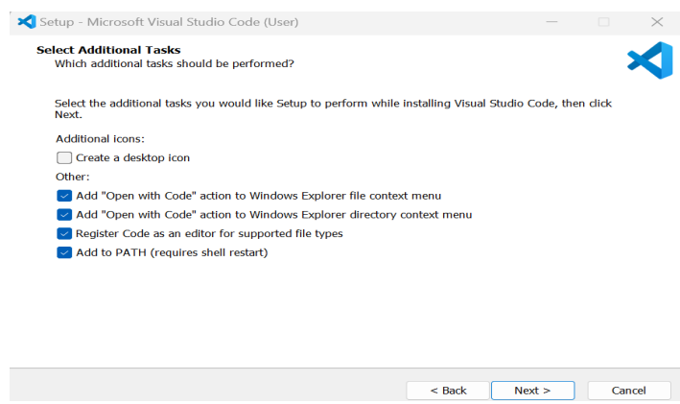
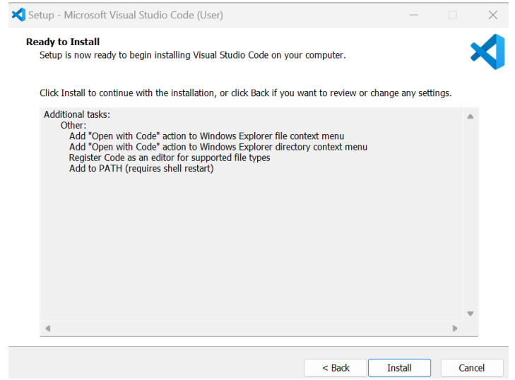
Step3: Click Next
Step4: Click Install Step5: Click Finish

Slide 15
GIT Setup
Git isn’t strictly necessary for using dbt (data build tool), but it is highly recommended—and in many workflows, especially collaborative or production environments, it's basically essential. Here's why:
1. Version Control
2. Collaboration
3. Deployment & CI/CD
4. Code Review
5. Integration with dbt Cloud
6. You can run dbt without Git, but:
It’s like writing code without saving versions.
For teams, production workflows, and long-term maintenance—Git is not optional, it’s foundational.

